Slide 1
OSGi
Dan Trong Thai

Slide 2
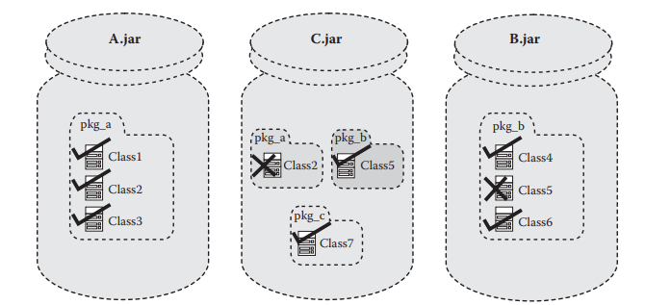
The Flat CLASSPATH Problem

Slide 3
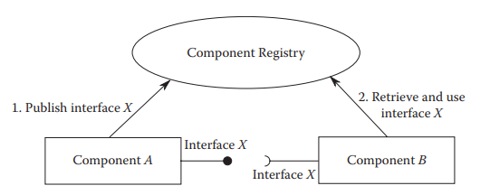
Whiteboard Model

Slide 4
Dependency Injection
Inversion of Control
Classes depend on abstraction
Objects define their dependencies without creating them
The Framework creates the object instead

Slide 5
OSGi
The Module Layer
Service Layer (Component Registry)
Bundles in OSGi
Consists of class files and resource files, like a JAR
+ Manifest information

Slide 6
Services in OSGi
Service Interface and a Service Object
API Operators
Declarative Services

Slide 7
Project Example of OSGi usage and Setter Injection

